Slide 1
Gynecological Emergencies
Department of Emergency Medicine
Johns Hopkins University
Center for International Emergency Disaster and Refugee Studies

Slide 2
Objectives
Sexually transmitted infections
Vulvovaginitis
Cervicitis
Pelvic inflammatory disease
Notes:
This is a two part lecture series. This first section addresses primarily infections of the female reproductive tract. The second lecture will focus on diseases that primarily cause pain or bleeding in the female patient.

Slide 3
Sexually transmitted infections
Gonorrhea
Chlamydia
Syphilis
Chancroid
Trichomoniasis
Granuloma Inguinale
Condyloma Accuminata
Herpes Progenitalis
Notes:
These are the most common to present to the ED.
For all sexually transmitted infections:
Concurrent infection is the rule rather than the exception.
Treat when infection suspected. Do not wait for culture results.
Do serologic tests of syphilis in any patient that presents with STI.
Pregnancy test should be done on all female patients with STI.
Counsel on prevention of STI and HIV infection.
Treat all partners.
We will briefly review all infections listed here

Slide 4

Sexually transmitted infections
In addition, Tanzanian guidelines note that for vaginal discharge during pregnancy, the cause is usually polymicrobial and thus combined drugs are needed:
  Erythromycin (O) 500 mg every 8 hours for 10 days PLUS
  Metronidazole (O) 400-500 mg every 8 hours for 7 days
  Avoid both drugs concomitantly if side effects are intolerable
  Avoid metronidazole in the first trimester
  Avoid alcohol while taking metronidazole
Notes:
The dose of Erythromycin should be reduced to every 8 hours if side effects are intolerable but the period should be extended appropriately.

Slide 5


Gonorrhea
Presentation
  Incubation period: 3-14 days
  May be asymptomatic
  Vaginal discharge, cervicitis, dysuria, PID, urethritis (purulent urethral discharge and/or dysuria), epididymitis, prostatitis, rectal infection, disseminated.
N. gonorrhea
Notes:
Rectal: discharge, pain, tenesmus, and/or constipation
up to 45% of patients have coexisting chlamydial infection

Slide 6
Gonorrhea
Diagnosis
  Neisseria Gonorrhea Gram negative intracellular diplococci
  Negative smears or cultures is common
Treatment
  Ceftriaxone drug of choice for uncomplicated cases in patients without contraindications
  Admit disseminated or conjunctival gonorrhea
  Treat Chlamydia trachomatis
Notes:
Rectal: discharge, pain, tenesmus, and/or constipation
up to 45% of patients have coexisting chlamydial infection

Slide 7

Chlamydia
Presentation
  Incubation period: 1 to 3 weeks
  May be asymptomatic
  Urethritis, cervicitis, PID, epididymitis, proctitis
  Lymphogranuloma venereum- localized, tender, inguinal lymphadenopathy
Notes:
Treat gonorrhea given incidence of coinfection

Slide 8
Chlamydia
Diagnosis
  Chlamydia trachomatis is an obligate intracellular bacteria, but culture low yield
Treatment
  Azithromycin 1g PO (one dose) or
  Doxycycline 100mg bid for 1 week
  Treat Gonorrhea
Notes:
Treat gonorrhea given incidence of coinfection

Slide 9
Syphilis
Primary Syphilis
  Chancre: painless, indurated ulcer
  Buboes: enlarged, non-tender, firm inguinal lymphadenopathy
Secondary Syphilis
  Diffuse lymphadenopathy
  Classic rash erythematous maculopapular lesions
Tertiary Syphilis
  Latent period
  Benign (gummatous) lesions of the skin, bones and viscera
  Cardiovascular and neurologic involvement
Notes:
Primary Syphilis
Chancre: a painless, indurated ulcer develops at the site of inoculation after 10-90 day incubation period. Lasts 3-6 weeks before resolving spontaneously
Buboes: enlarged, non-tender, firm inguinal lymphadenopathy that develops 4-6 weeks after initial exposure
Secondary Syphilis
constitutional signs and symptoms (6-12 wks after primary stage)
Diffuse lymphadenopathy
Classic rash consists of erythematous maculopapular lesions that are nonpruritic, symmetric, and involve the palms and soles
Tertiary Syphilis
occurs after latent period of several years
characterized by benign (gummatous) lesions of the skin, bones and viscera as well as cardiovascular and neurologic involvement (thoracic aneurysm, tabes dorsalis, dementia, and meningitis)

Slide 10
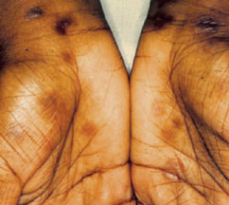
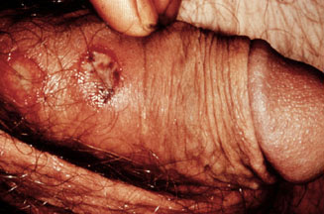
Syphilis
Exanthem of secondary syphilis
Syphilitic chancre
Diagnosis
  Treponema pallidum, a spirochete
  Dark field microscopy, serologic tests RPR,VDRL, or FTA
Treatment
  Penicillin 2.4 million units IM (doxycycline if allergic)
  Tertiary/Latent stages require multiple doses
Notes:
Diagnosis
Dark field microscopy for treponemes in primary and secondary lesions
Serologic tests include nontreponemal (RPR and VDRL) and specific treponemal antibody tests (FTA)
Treatment
Remains very sensitive to penicillin and 2.4 million units IM is the regimen of choice (doxycycline for allergic pts)
Tertiary/Latent stages require multiple doses

Slide 11
Chancroid
Presentation
  Incubation period: 1-5 days
  Painful necrotic ragged ulcer
  Bubo formation
Diagnosis
  Hemophilus ducreyi
  Gram stain bubo aspiration may reveal gram negative rods in linear or parallel formation (“school of fish”)
Treatment
  IM Ceftriaxone or azithromycin
Notes:
Bubo formation: painful inguinal lymphadenopathy that is often suppurative and associated with extensive tissue destruction

Slide 12
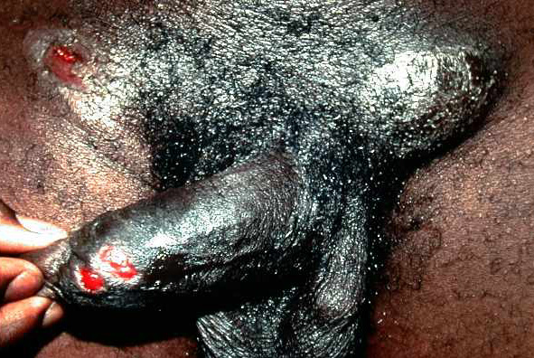
Chancroid
Characteristic lesions of chancroid.
Bubo on the right side drained spontaneously.
Bubo in the left inguinal canal required needle aspiration

Slide 13
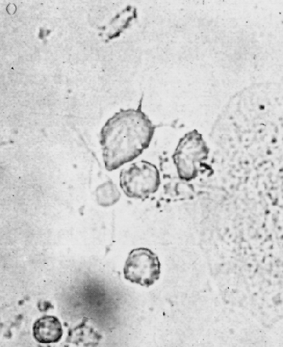
Trichomoniasis
Trichomonad
Presentation
  Incubation period: 1 week
  Asymptomatic in men
  Malodorous, frothy, itchy vaginal discharge; “strawberry” cervix
Diagnosis
  Wet mount reveals flagellated protozoan Trichomonas vaginalis
Treatment
  Metronidazole 2g once or 500 mg bid for 1 week
Notes:
Presentation
“strawberry” cervix: stippled or punctate “strawberry” appearance of cervical or vaginal mucosa
Treatment
Patients must avoid alcohol for 24 hours after last dose to avoid a possible “Antabuse” reaction from the metronidazole
PICTURE: Characteristic configuration of a trichomonad seen in wet smear at high-power magnification.

Slide 14
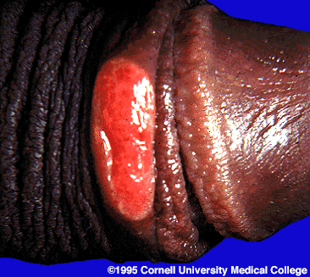
Granuloma inguinale
Presentation
  Incubation period: 8-12 weeks
  Rare STI
  Beefy red ulcer and Pseudobubos
Diagnosis
  Microscopy of Donovan bodies from Calymmatobacterium granulomatis
Treatment
  Bactrim or doxycycline
Notes:
Presentation
Disease progresses from a painless papule, nodule, or vesicle of the genitalia to beefy red, friable, sharply demarcated ulcers to subcutaneous granulomas (pseudobubos) in the inguinal nodes
In severe untreated cases, extensive tissue destruction may occur which may progress to squamous cell carcinoma
Diagnosis
Microscopy of tissue scrapings or biopsies may reveal Donovan bodies (monocytes engulfing clusters of organisms that resemble microscopic safety pins)

Slide 15
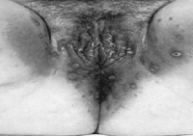
Condyloma accuminata
Presentation
  Incubation period: 3-4 months
  “Genital warts”
  Painless
  Implicated in cervical cancer
Diagnosis
  Human papilloma viruses
  Clinical
Treatment
  Cryotherapy (not performed in ED)
  Lesions will recur
Condylomata acuminata of the vulva
Notes:
Diagnosis
Distinguished from condyloma lata of syphilis by more fleshy pedunculated appearance
Treatment
Cryotherapy with liquid nitrogen or 25% podophyllin in tincture of benzoin

Slide 16
Herpes progenitalis
Presentation
  Incubation period: 8-16 days
  Recurring, painful, vesicular lesions in clusters on erythematous base on cervix, vulva, glans, prepuce
  Prodrome
Diagnosis
  Caused by HSV type II, sometimes type I
  Clinical
  Tzanck smear or culture multinucleated giant cells
Treatment
  Acyclovir for primary infection, less effective for recurrences
Notes:
Clinical Presentation
Attacks are often heralded by a prodrome of pain, hyperesthesia, burning, or paresthesias at the skin site
headache, fever, arthralgias, and regional lymphadenopathy may be present, particularly with the first clinical episode.
Treatment
Acyclovir is the antiviral agent of choice and accelerates healing, shortens the duration of shedding, and provides partial control of symptoms (famciclovir and valacyclovir are acceptable alternatives)
Topical therapy not effective

Slide 17

Vulvovaginitis
Inflammation of the vagina and external genitalia
Common
Causes
  Infection
  Irritants and allergies
  Foreign bodies
  Atrophy
Notes:
Of the causes we will only discuss the infectious etiologies.
These are trichomonas and herpes (which we just talked about) and candida and bacterial vaginosis.
Irritants and allergies typically only require the removal of the offending agent. Topical corticosteroids may be helpful.
Removal of foreign bodies (toilet paper, small objects, tampons) resolves symptoms
Atrohpy because of lack of estrogen in peri- or menopausal women. Topical estrogen cream helps.

Slide 18
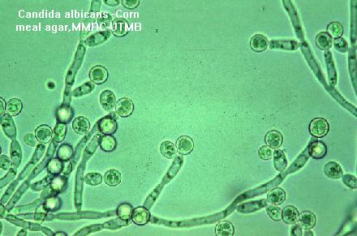
Vulvovaginal candidiasis
Presentation
  Extreme itching with thick, white, “cottage cheese” discharge with erythema/edema and satellite lesions; dysuria or dyspareunia
Diagnosis
  Candida albicans
  10% KOH prep
  Pseudohyphae and spores
Treatment
  Imidazoles (oral or topical)
Notes:
Diagnosis
Caused by colonization or overgrowth of Candida albicans from 1) DM 2) pregnancy and post-menopause 3) drugs (oral contraceptives, abx, steroids) 4) menstruation
Treatment
Nonpregnant patient: Fluconazole 150 mg PO in one dose or intravaginal preparation qHS for 3 days
Pregnant patients require intravaginal preparations

Slide 19
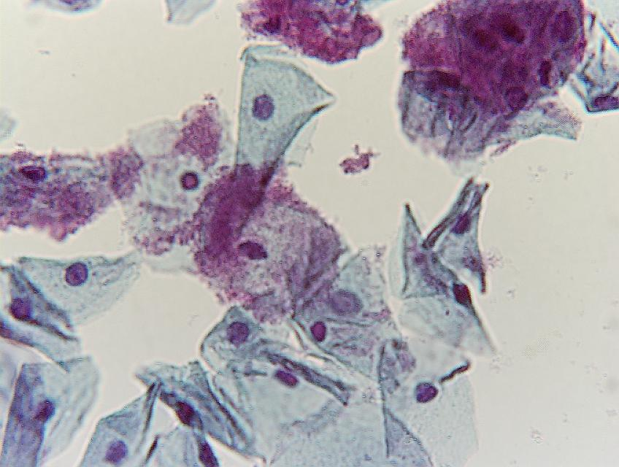
Bacterial vaginosis
Presentation
  Most common cause vaginal discharge and odor; mild itching
  Vaginal flora replaced by Gardnerella vaginalis and Mycoplasma hominis (anaerobes)
Diagnosis (need 3 out 4)
  Frothy grey-white discharge
  pH > 4.5
  Clue cells on wet mount
  Positive amine odor test (“fishy” odor with KOH)
Treatment
  Metronidazole (oral or intravaginal gel), clindamycin.
Clue cells
Notes:
Etiology
Previously thought to be caused by a single organism (Gardnerella), now thought to be from multiple anaerobes
Believed to result from changes in vaginal microflora. There is synergystic activity of the normal mixed flora and anaerobes which ultimately results in the predominance of the anaerobic organisms
Treatment
Routine treatment of pregnant women is NOT recommended.

Slide 20

Cervicitis
Presentation
  Vulvovaginal area is normal
  Cervix friable, inflamed with purulent discharge with dysuria
  May be asymptomatic
Diagnosis
  Primary pathogens
    chlamydia, gonorrhea, and/or trichomonas
  Culture (GC/chlamydia), wet mount, gram stain
Treatment
  Treat offending organism, usually all 3
Notes:
If only WBCs seen “assume” chlamydia
Remember caution with pregnancy and certain medications

Slide 21


Pelvic inflammatory disease
Etiology
  Ascension from asymptomatic cervicitis
  Usual source: STI
  Risk factors
    Multiple sexual partners, previous PID, adolescence, IUD, instrumentation of cervix/uterus, recent menses, douching, cigarette smoking
  Normal host barriers
    cervical mucus, lysozymes, local immunoglobulin IGA, and the cervix itself
  Rare during pregnancy
Notes:
During pregnancy the cavity between the cervix and fallopian tubes is obliterated and changes in cervical mucus occur, making PID a very uncommon event. PID may occur in the first trimester, however, and may result in fetal loss

Slide 22
Pelvic inflammatory disease
Clinical presentation
  Sexually active young female complaining of bilateral lower abdominal pain for several days (often following menses) and abnormal vaginal discharge
  “Classic” picture only present in 1/3 of cases
  Constitutional symptoms may be present

Slide 23



Pelvic inflammatory disease
Diagnosis
Major criteria must be present:
  Lower abdominal pain
  Tenderness on lower abdominal examination
  Cervical motion tenderness
  Adnexal tenderness
Notes:
Some clinicians cite that three out of the four criteria must be present

Slide 24

Pelvic inflammatory disease
Diagnosis
Enhance the specificity of diagnosis:
  Temperature greater than 101ºF (38.3ºC)
  Abnormal cervical or vaginal discharge
  Laboratory evidence of GC or chlamydia
  Elevated ESR or CRP
Laparoscopy is the most accurate way to diagnose PID
Notes:
Laparoscopy is the most accurate way to diagnose PID
Laparoscopy allows direct visualization and culture of involved organs, may help exclude other diseases (appendicitis, diverticular disease)

Slide 25

Pelvic inflammatory disease
Treatment
  Outpatient: antibiotics
    Cover gonorrhea, chlamydia, anaerobes, gram negative rods, and streptococci
  Treat pain and dehydration
  Sexual partners must be treated
Notes:
Outpatient: multiple regimens exist
Ceftriaxone 250 mg IM (or cefoxitin plus probenicid) plus doxycycline 100 mg PO bid x 14 days
ofloxacin 400 mg bid for 14 days plus metronidazole 500 PO bid x 14 days (better anaerobic coverage but does not cover incubating syphilis and is more expensive)
Treat sexual partners if they have had sexual contact within 60 days of symptom onset

Slide 26

Pelvic inflammatory disease
Treatment
  Admission criteria:
    Toxic patients with persistent N/V
    Failure to respond to PO abx within 72º
    Pelvic abscess demonstrated or suspected
    Concurrent pregnancy or immunosuppression
Notes:
Go over all these admission criterias, it is very important
All regimens should cover GC, chlamydia, anaerobes, gram negative rods, and streptococci
Remember to treat pain and dehydration
Sexual partners must be treated

Slide 27
Pelvic inflammatory disease
Treatment
  Admission criteria:
    Uncertain diagnosis
    Intrauterine device in place
    Unlikely compliance with outpatient regimen
    Significant fertility issues
    Adolescence
Notes:
Go over all these admission criterias, it is very important
All regimens should cover GC, chlamydia, anaerobes, gram negative rods, and streptococci
Remember to treat pain and dehydration
Sexual partners must be treated

Slide 28
Tanzanian Guidelines
Tanzanian Guidelines suggest in acute PID give IV dextrose 5% and
  Cotrimoxazole (O) 500 mg every 6 hours for 14 days and
  Metronidazole (O) 400-500 mg every 8 hours for 10 days
  ASA (O) 600 mg every 8 hours preferably after food.
  In addition, in chronic PID, give an appropriate analgesic aspirin or paracetamol depending on the severity of the pain.

Slide 29
Pelvic inflammatory disease
Clinical importance
  Cause of ectopic pregnancy, infertility, and chronic pelvic pain
Complications
  Formation of tubo-ovarian abscess
  Fitz-Hugh-Curtis Syndrome (perihepatitis)
  Obstetrical complications

Slide 30
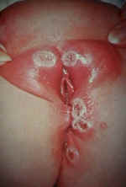
Case
25 year old female sexually active presents with burning on urination and pain in her perineal region. Noted lesions on her vulva. Has had these in the past before.
?
Notes:
What is the lesion that you see here?
Hint: vesicular, multiple, on an erythematous base
Herpes progenitalis

Slide 31
Case
Answer:
  Herpes progenitalis
What is the cause?
What do you see on smear or culture?
What is treatment?
Notes:
Cause: herpes simplex virus type II, usually, may also be type I
Tzanck smear: multinucleated giant cells
Treatment: Acyclovir to accelerate healing, shorten the duration of shedding, and provide partial control of symptoms (famciclovir and valacyclovir are acceptable alternatives)
Topical therapy not effective.

Slide 32
Gynecological Emergencies II
Department of Emergency Medicine
Johns Hopkins University
Center for International Emergency Disaster and Refugee Studies

Slide 33
Overview
Adnexal torsion
Hemorrhagic corpus luteum cyst
Bartholin’s gland abscess
Endometriosis
Uterine fibroids (leiomyomas)
Dysfunctional uterine bleeding
Mittelschmerz
Uterine Prolapse
Notes:
This is the second lecture of a two part series. The first lecture focused primarily on infections. This section will address some diseases that primarily cause pain and/or abnormal bleeding. Female patients will present to the casualty department for pain and bleeding that may or may not be related to pregnancy and infection.

Slide 34
Adnexal torsion
Etiology
Abnormal ovary or fallopian tube twists around its vascular pedicle
  Ischemia and eventual necrosis
Ovarian torsion
  Enlarged ovary (due to a cyst or tumor)
  Overstimulation (use of fertility drugs)
Fallopian tube torsion
  Hydrosalpinx, neoplasm, adhesions, trauma, or previous ligation
Notes:
Tumors are found in 50 to 60% of patients

Slide 35

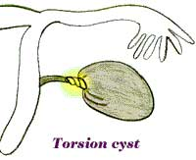
Adnexal torsion
Clinical Presentation
Severe, sudden unilateral pain during or immediately after sexual intercourse
History of similar episodes in the past that resolved spontaneously
Pelvic exam
  Unilateral adnexal tenderness
  Small, discrete tender mass
Notes:
Patients often remember the exact time of onset
Vital signs may show an absence of fever or tachycardia that is out of proportion to the fever
Pelvic exam: CMT is often present, bilateral adnexal tenderness does occur in some patients; inflammatory masses tend to be larger and less well-defined

Slide 36
Adnexal torsion
Diagnosis
Routine labs usually normal
Pregnancy test
Culdocentesis
  Serosanguinous fluid (from hemorrhagic necrosis)
Ultrasound
  Adnexal mass and evaluate blood flow
Laparoscopy
  Definitive diagnostic procedure
Notes:
Pregnancy test: rule out ectopic or concomitant IUP

Slide 37
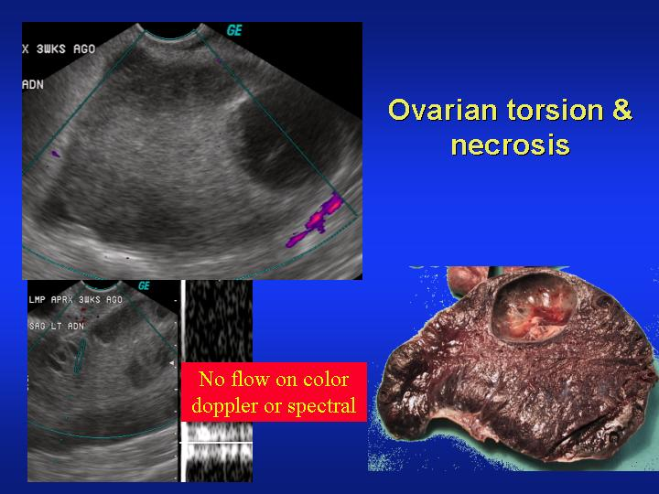

Slide 38
Adnexal torsion
Treatment
Surgical correction or resection
  Definitive therapy of choice
Laparoscopy
Complications
Scarred tube
  Infertility
  Tubal pregnancy
Ovarian necrosis
  Peritonitis and shock
Notes:
Laparascopy: being increasingly used since “untwisting” may be possible if diagnosed early

Slide 39
Hemorrhagic corpus luteum cyst
Etiology
Corpus luteum of pregnancy
  Persists up to 8 weeks into the pregnancy
  Occurs in nonconception cycles for unknown reasons
Hemorrhage into the cyst
  Capsular stretching and pain
Cyst rupture
  Sharp pain and peritoneal irritation
Notes:
CL is formed from the follicular capsule after release of the mature oocyte and secretes estrogen and progesterone to maintain the endometrium. If fertilization and implantation occur hcg is secreted by the embryo and signals the CL to continue secreting .
May grow from 5 to 10 cm in diameter
Degeneration is followed by heavy menstrual bleeding

Slide 40
Hemorrhagic corpus luteum cyst
Clinical Presentation
May be indistinguishable from ruptured ectopic pregnancy
Sudden onset of unilateral lower abdominal pain
Clue: an amenorrheic patient or one early in pregnancy
Hemorrhage usually self-limited
  Can cause anemia and hypovolemia

Slide 41
Hemorrhagic corpus luteum cyst
Diagnosis
Pregnant patients positive pregnancy test and ultrasound will show an IUP and possibly the cyst
Laparoscopy
  Definitive diagnosis
  Assess bleeding
Treatment
Admission for observation and serial hematocrits
Treatment is surgical (ovarian cystectomy)
  Unless cystic bleeding has stopped and the patient is stable

Slide 42
Bartholin’s gland abscess
Etiology
  Infectious obstruction of duct leading from gland to vaginal opening
Presentation
  Unilateral painful swelling of the labia
  Fluctuant mass 1-2cm
Diagnosis
  Clinical
  Cervical cultures should be obtained
Notes:
Gonorrhea and chlamydia common

Slide 43
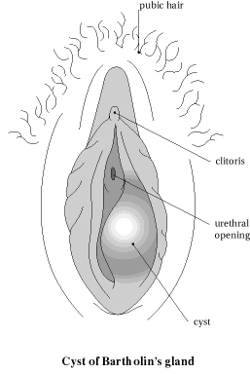
Bartholin’s gland abscess
Treatment
  Incision and drainage along vaginal mucosa
  Insertion of Word catheter
  Routine antibiotic treatment not indicated
Recurrence
  Marsupialization
Notes:
Marsupialization procedure:
A vertical skin incision is made over the cyst just external to the hymenal ring.
After opening the cyst wall and draining its contents,
Edges of the cyst’s lining are turned out and sewn back against the skin incision with absorbable sutures.

Slide 44
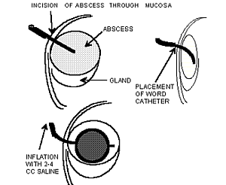
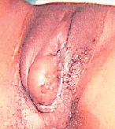
Notes:
Here is the description of placement of word catheter

Slide 45
Endometriosis
Etiology
  Normal endometrium in ectopic locations
  7-10% of women
    half experience symptoms
  Present in 40% with infertility
  Present in 80% with chronic pelvic pain
  All pelvic structures may be affected
  Second most common cause of midcycle pain
Notes:
Most common cause of pain: dysmenorrhea

Slide 46
Endometriosis
Presentation
  Dysmenorrhea radiates to back, dyspareunia
  Spotting 3-7 days before menses
  Tenesmus, hematochezia, hematuria
  Rupture of ovarian endometrioma: peritonitis with acute pain
Notes:
Presentation and Clinical Findings
If the lesions extend into the colon or bladder then cyclic, perimenstrual tenesmus, hematochezia, or hematuria can occur. Tender nodules in the posterior fornix of the vagina are classic findings in the presence of endometriosis. If the ovaries are involved, adhesions and tender cyst-like structures filled with old blood (chocolate cysts) may occur.
Treatment
Medical treatment involves the use of pain medications (usually NSAIDs) and hormonal manipulation to suppress estrogen levels.
Surgical treatment is indicated for correction of pain, infertility, or other symptoms in patients with extensive endometriosis, or when hormonal manipulation therapy fails to adequately treat the problem. In those patients who have completed their childbearing desires and have severe symptoms from endometriosis a total abdominal hysterectomy with bilateral salpingo-oophorectomy (TAB/BSO) and resection of endometriosis lesions can be offered as definitive therapy for the disease.

Slide 47
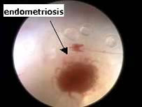
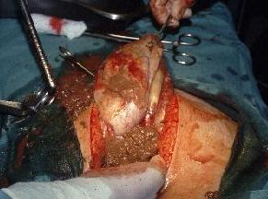
Endometriosis
Diagnosis
  Visualization via laparoscopy or lapartomy required
Treatment
  Analgesia
  Hormonal therapy to suppress estrogen
  Surgical
Notes:
Presentation and Clinical Findings
If the lesions extend into the colon or bladder then cyclic, perimenstrual tenesmus, hematochezia, or hematuria can occur. Tender nodules in the posterior fornix of the vagina are classic findings in the presence of endometriosis. If the ovaries are involved, adhesions and tender cyst-like structures filled with old blood (chocolate cysts) may occur.
Treatment
Medical treatment involves the use of pain medications (usually NSAIDs) and hormonal manipulation to suppress estrogen levels.
Surgical treatment is indicated for correction of pain, infertility, or other symptoms in patients with extensive endometriosis, or when hormonal manipulation therapy fails to adequately treat the problem. In those patients who have completed their childbearing desires and have severe symptoms from endometriosis a total abdominal hysterectomy with bilateral salpingo-oophorectomy (TAB/BSO) and resection of endometriosis lesions can be offered as definitive therapy for the disease.
Above are the view from the laproscopic and lapartomy respectively

Slide 48
Uterine fibroids (leiomyomas)
Etiology
  Most common pelvic tumor: benign
  Often multiple
  30% women have associated pelvic pain and bleeding
  Acute pain rare
    Torsion of pedunculated fibroid
    Degenerated (infarct) in pregnant patients
Presentation
  Lower abdominal pain
Notes:
Acute pain is rare. It may occur in these situations…
Degenerated (infarct) in pregnant patients: rapid growth outstrips blood supply, hence acute pain.

Slide 49
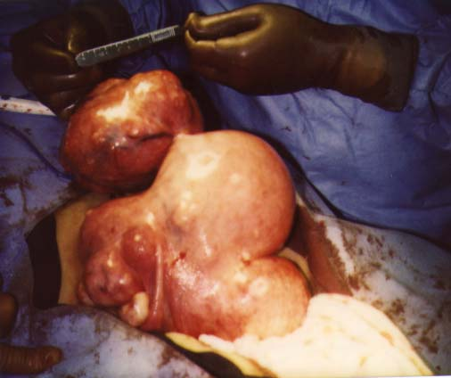
Uterine fibroids (leiomyomas)
Diagnosis
  Enlarged uterus or palpable masses
  Ultrasound: confirmatory
Treatment
  Analgesia
  Gonadotropin releasing hormone
  Myomectomy or hysterectomy
Notes:
These tumors can attain a very large size even exceeding that of a term pregnancy. (pictured above)
GnRH agonists administered over 3 to 4 months can cause shrinkage of up to 50% volume in these tumors, but they will regain their original size several months after the GnRH is discontinued. However GnRH therapy is useful in allowing a patient’s anemia to resolve prior to surgical removal of the fibroids.
A patient with symptomatic fibroids who has completed her childbearing may desire to have a hysterectormy, or may choose to remove the fibroids surgically (myomectomy) can be done.

Slide 50
Dysfunctional uterine bleeding
Etiology
  Abnormal bleeding in absence of anatomic lesions of uterus
  Hormonal imbalance
    Irregular ovulation
    No cyclic production of progesterone
  Anovulation
    Unopposed estrogen stimulation of endometrium
    Heavy bleeding secondary to uncoordinated endometrial sloughing
  Extremes of menstrual life

Slide 51
Dysfunctional uterine bleeding
Presentation
  Prolonged or intermenstrual bleeding.
  Usually not heavy.
Diagnosis
  Consider coagulopathy especially in young women
Treatment
  No immediate intervention required
  Hemodynamically stable: hormone therapy
  Hemodynamically unstable: resuscitation, IVF, blood products; dilation and curretage

Slide 52
Mittelschmerz – “middle pain”
Etiology
  Midcycle pain at ovulation
  Day 14-16 of menstrual cycle
Presentation
  Unilateral, mild to moderate pain
  Duration 1 day or less
  Light spotting possible
Notes:
Most common in younger women.

Slide 53
Mittelschmerz – “middle pain”
Diagnosis
  Clinical
  Exclude other causes of pain
  Pelvic exam
    Adnexal tenderness with no mass
Treatment
    Self-limited
    Symptomatic treatment with analgesics

Slide 54
Tanzanian guidelines
Tanzanian guidelines recommend:
  Ibuprofen 200-600 mg every 8 hours OR
  ASA 300-600 mg every 4 hours OR
  Diclofenace 25 mg 2-3 times/day
  Treat the underlying condition if known – most are primary cause (no organic cause).

Slide 55
Uterine prolapse
Etiology
  Extrusion of female reproductive organs.
  Causes
    Multigravidas
    Hereditary factors
    Weakness of musculature and connective tissue
    Estrogen deficiency
  Predispositions
    Manual labor with heavy lifting
    Frequent coughing
    Obesity
    Chronic constipation
Notes:
The cause of pelvic organ prolapse is multifactional, but is related to damage during childbirth, heredity factors, and age related weakness of muscles and connective tissue which is often exacerbated by estrogen deficiency following menopause.
Presentation, Clinical Findings, and Diagnosis
Activities that constantly exert pressure against the pelvic organ support systems such as manual labor with heavy lifting, frequent coughing, obesity, or chronic constipation also tend to worsen prolapse problems. Many women tend to ignore the prolapse until it causes functional problems of the bladder or rectum.
Treatment
For mild prolapse, treatment involves exercises of the pelvic floor muscles (Kegel) and using intravaginal estrogen creams weekly if the patient is menopausal. For more advanced prolapse problems vaginal pessaries are helpful to correct the acute problem, but in the long term if the patient’s health is otherwise good corrective surgery should be done.

Slide 56
Uterine prolapse
Presentation
  Functional problems of bladder and rectum
Treatment
  Pelvic floor strengthening exercises
    Kegel exercises
  Intravaginal estrogen creams
  Advanced prolapse
    Vaginal pessaries
    Surgical correction

Slide 57
Case
15 year old female complains of sudden, sharp lower right abdominal pain. Has had similar symptoms in the past, but pain always resolved. No fever. No vaginal discharge. Not sexually active.
PE: tender and fullness felt in the right adnexa. Otherwise negative exam
Pregnancy test is negative
What would you like to do?
Notes:
Patient should get an ultrasound.
Can also check labs.

Slide 58
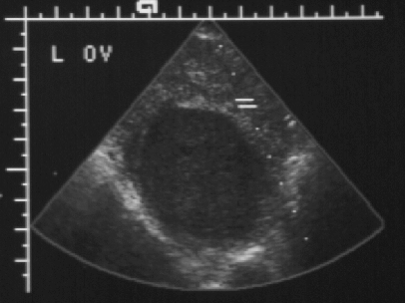
Notes:
Ok, what are you seeing and what might be going on

Slide 59

Case
Ultrasound:
  Large cyst on her right ovary
  Decreased blood flow is seen
What is the next management step?
Notes:
Patient should be admitted for immediate surgical correction and/or resection of her ovarian torsion.
Note: every effort should be made to salvage the ovary, if possible, because of the age of this person.

